Slide 1
STANDARD TEMPLATE LIBRARY(STL)

Slide 2
Learning objectives
Overview of STL
Key components
Demonstration

Slide 3
STL
Generic programming
  Templates
      Functions
      Classes
To help C++ user in generic programming, a set of general purpose templatized classes (Data structures) and functions (algorithms) that could be used as a standard approach for storing and processing data.
The collection of these classes and functions is called Standard Template Library (STL).

Slide 4
Use and Application of STL
?

Slide 5
Standard Template Library
The standard template library (STL) contains
  Containers
  Algorithms
  Iterators
A container is an object that actually stores data. It is a way data is organized in memory, for example an array of elements.
Algorithms in the STL are procedures that are applied to containers to process their data, for example search for an element in an array, or sort an array.
Iterators is an object (like a pointer)that points to an element in a container.we can use iterators to move through the contents of containers.For example you can increment an iterator to point to the next element in an array

Slide 6
Containers, Iterators, Algorithms
Algorithms use iterators to interact with objects
stored in containers
Container
Container
Iterator
Algorithm
Objects
Iterator
Algorithm
Iterator
Iterator
Algotemplaterithm

Slide 7
Containers
Sequential container
Associative container
Derived container

Slide 8
Containers
A container is a way to store data, either built-in data types like int and float, or class objects
The STL provides several basic kinds of containers
  <vector> : one-dimensional array
  <list> : double linked list
  <deque> : double-ended queue
  <queue> : queue
  <stack> : stack
  <set> : set
  <map> : associative array

Slide 9
Sequence Containers
A sequence container- stores a set of elements in sequence, in other words each element (except for the first and last one) is preceded by one specific element and followed by another,
  <vector>
  <list>
  <deque>
  In an ordinary C++ array the size is fixed and can not change during run-time, it is also tedious to insert or delete elements. Advantage: quick random access

Slide 10
Sequence Containers
<vector> is an expandable array (dynamic array) that can shrink or grow in size, but still has the disadvantage of inserting or deleting elements in the middle. Allows insertions and deletions at back.
<list> is a double linked list (each element has points to its successor and predecessor), it is quick to insert or delete elements but has slow random access.
<deque> is a double-ended queue, that means one can insert and delete elements from both ends, it is a kind of combination between a stack (last in first out) and a queue (first in first out) and constitutes a compromise between a <vector> and a <list>

Slide 12
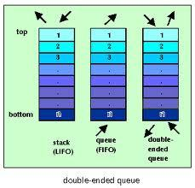
deque

Slide 13
Associative Containers
An associative container are designed to support direct access to elements using keys and they are non-sequential.
  The keys, typically a number or a string, are used by the container to arrange the stored elements in a specific order, for example in a dictionary the entries are ordered alphabetically.
There are 4 types of associative containers:
  Set
  Multiset
  Map
  Multimap
All these store data in a structure called tree which facilitates fast searching, deletion and insertion but slow for random access and inefficient for sorting.

Slide 14
Associative Containers
A <set> stores a number of items which contain keys.The keys are the attributes used to order the items, for example a set might store objects of the class.
Person which are ordered alphabetically using their name
A <map> stores pairs of objects: a key object and
an associated value object. A <map> is somehow
similar to an array except instead of accessing its
elements with index numbers, you access them with indices of an arbitrary type.
<set> and <map> only allow one key of each value, whereas <multiset> and <multimap> allow multiple identical key values

Slide 15
Derived containers
The containers derived from different sequence containers.
Derived containers
  Stacks
  Queues
  Priority Queues
Also known as container adaptors
These do not support iterators so can not be used for data manipulation.
However , they support two member functions
  Pop()
  Push()

Slide 16
Algorithms
Algorithms are the functions that can be used generally across a variety of containers for processing of their contents.
Each containers provides functions for basic operations.
STL provides sixty standard algorithms to support more extended or complex operations.
STL algorithms are not member functions or friends of containers
These Standard algorithms are standalone templates.
STL algorithms reinforce the philosophy of reusability.
Include <algorithm>

Slide 17
Algorithms
STL algorithms, based on the nature of operations they perform, may be categorized as under:
  Retrieve or non mutating algorithms.
  Mutating algorithms
  Sorting algorithms
  Set algorithms
  Relational algorithms

Slide 18
Algorithms
Non-mutating algorithms
for_each() Do specified operation for each element in a sequence
Find() Find the first occurence of a specified value in a sequence
find_if() Find the first match of a predicate in a sequence
find_first_of() Find the first occurence of a value from one sequence in another
adjacent_find() Find the first occurence of an adjacent pair of values
Count() Count occurences of a value in a sequence
count_if() Count matches of a predicate in a sequence
Accumulate() Accumulate (i.e., obtain the sum of) the elements of a sequence
Equal() Compare two ranges
max_element() Find the highest element in a sequence
min_element() Find the lowest element in a sequence

Slide 19
Copy() Copy range of elements
copy_n() Copy elements (function template )
copy_if() Copy certain elements of range (function template )
copy_backward()Copy range of elements backward (function template )
Move() Move range of elements (function template )
move_backward() Move range of elements backward (function template )
Swap() Exchange values of two objects (function template
swap_ranges()Exchange values of two ranges (function template )
iter_swap() Exchange values of objects pointed by two iterators (function template
Transform() Transform range (function template )
Replace() Replace value in range (function template )
replace_if() Replace values in range (function template )
replace_copy() Copy range replacing value (function template )
replace_copy_if() Copy range replacing value (function template )

Slide 20
Fill() Fill range with value (function template )
fill_n() Fill sequence with value (function template )
Generate() Generate values for range with function (function template )
generate_n() Generate values for sequence with function (function template )
Remove() Remove value from range (function template )
remove_if() Remove elements from range (function template)
remove_copy()Copy range removing value (function template)
remove_copy_if()Copy range removing values (function template )
Unique()Remove consecutive duplicates in range (function template)
unique_copy()Copy range removing duplicates (function template)
Reverse()Reverserange (function template )
reverse_copy()Copy range reversed (function template )
Rotate() Rotate left the elements in range (function template )
rotate_copy() Copy range rotated left (function template )
random_shuffle()Randomly rearrange elements in range (function template)
shuffle () Randomly rearrange elements in range using generator (function template )

Slide 21
Sorting Agorithms
Sort()Sort elements in range (function template )
stable_sort Sort elements preserving order of equivalents (function template )
partial_sort Partially sort elements in range (function template )
partial_sort_copy Copy and partially sort range (function template )
is_sorted Check whether range is sorted (function template )
is_sorted_until Find first unsorted element in range (function template )
nth_elementSort element in range (function template )

Slide 22
Binary search (operating on partitioned/sorted ranges):
lower_boundReturn iterator to lower bound (function template )upper_boundReturn iterator to upper bound (function template )equal_rangeGet subrange of equal elements (function template )binary_searchTest if value exists in sorted sequence (function template )

Slide 23
Vector Container
int array[5] = {12, 7, 9, 21, 13 };
vector<int> v(array,array+5);
12
7
9
21
13
v.pop_back();
v.push_back(15);
13
…
12
7
9
21
12
7
9
21
15
0 1 2 3 4
12
7
9
21
15
v.begin();
v[3]

Slide 24
Vector Container
#include <vector>
#include <iostream>
main()
{
vector<int> v(3); // create a vector of ints of size 3
v[0]=23;
v[1]=12;
v[2]=9; // vector full
v.push_back(17); // put a new value at the end of array
for (int i=0; i< v.size(); i++) // member function size() of vector
cout << v[i] << ” ”; // random access to i-th element
cout << endl;
}

Slide 25
Vector Container
#include <vector>
#include <iostream>
main()
{
int arr[] = { 12, 3, 17, 8 }; // standard array
vector<int> v(arr, arr+4); // initialize vector with array
while ( ! v.empty()) // until vector is empty
{
cout << v.back() << ” ”; // output last element of vector
v.pop_back(); // delete the last element
}
cout << endl;
}

Slide 26
Iterators
Iterators are pointer-like entities that are used to access individual elements in a container.
Often they are used to move sequentially from element to element, a process called iterating through a container.
vector<int>
array_
17
vector<int>::iterator
4
23
The iterator corresponding to
the class vector<int> is of
the type vector<int>::iterator
12
size_
4

Slide 27
Iterators
The member functions begin() and end() return an
iterator to the first and past the last element of a container
vector<int> v
v.begin()
array_
17
4
23
12
v.end()
size_
4

Slide 28
The iterator corresponding to
vector<int> ::iterator itr

Slide 29
Iterators
One can have multiple iterators pointing to different or identical elements in the container
vector<int> v
i1
array_
17
4
i2
23
12
i3
size_
4

Slide 30
Iterators
#include <vector>
#include <iostream>
main()
{
int arr[] = { 12, 3, 17, 8 }; // standard array
vector<int> v(arr, arr+4); // initialize vector with array
for (vector<int>::iterator i=v.begin(); i!=v.end(); i++)
// initialize i with pointer to first element of v
// i++ increment iterator, move iterator to next element
{
cout << *i << ” ”; // de-referencing iterator returns the
// value of the element the iterator points at
}
cout << endl;
}

Slide 31
Iterator Categories
Not every iterator can be used with every container for example the list class provides no random access iterator
Every algorithm requires an iterator with a certain level of capability for example to use the [] operator you need a random access iterator
Iterators are divided into five categories in which a higher (more specific) category always subsumes a lower (more general) category, e.g. An algorithm that accepts a forward iterator will also work with a bidirectional iterator and a random access iterator
input
forward
bidirectional
random
access
output

Slide 32
Find() Algorithm
#include <vector>
#include <algorithm>
#include <iostream>
main() {
int key;
int arr[] = { 12, 3, 17, 8, 34, 56, 9 }; // standard array
vector<int> v(arr, arr+7); // initialize vector with array
vector<int>::iterator iter;
cout << ”enter value that you want to searh :”;
cin >> key;
iter=find(v.begin(),v.end(),key); // finds integer key in v
if (iter != v.end()) // found the element
cout << ”Element ” << key << ” found” << endl;
else
cout << ”Element ” << key << ” not in vector v” << endl; }

Slide 33
List Container
An STL list container is a double linked list, in which each element contains a pointer to its successor and predecessor.
It is possible to add and remove elements from both ends of the list
Lists do not allow random access but are efficient to insert new elements and to sort and merge lists

Slide 35
List Container
int array[5] = {12, 7, 9, 21, 13 };
list<int> li(array,array+5);
12
7
9
21
13
li.pop_back();
li.push_back(15);
13
…
12
7
9
21
12
7
9
21
15
li.pop_front();
li.push_front(8);
12
…
7
9
21
8
12
7
9
21
15
li.insert()
19
7
12
17
21
23

Slide 36
Associative Containers
In an associative container the items are not arranged in sequence, but usually as a tree structure or a hash table.
The main advantage of associative containers is the speed of searching (binary search like in a dictionary)
Searching is done using a key which is usually a single value like a number or string
The value is an attribute of the objects in the container
The STL contains two basic associative containers
  sets and multisets
  maps and multimaps

Slide 37
Maps and Multimaps
A map stores pairs <key, value> of a key object and associated value object.
The key object contains a key that will be searched for and the value object contains additional data
The key could be a string, for example the name of a person and the value could be a number, for example the telephone number of a person

Slide 38
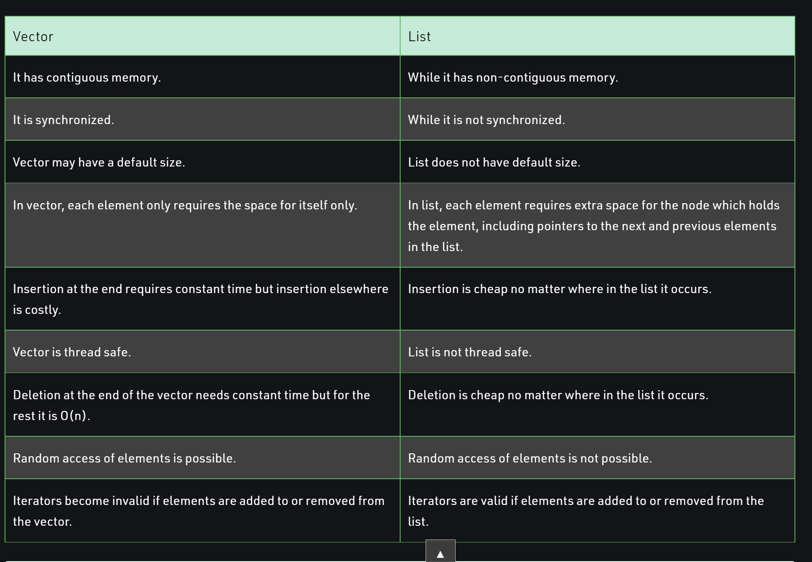
Source geeksforgeeks

Slide 39
The following are the differences between vector and array −
Vector occupies more memory.
Array is memory efficient data structure.
Vector takes more time in accessing elements.
Array access elements in constant time irrespective of their location as elements are arranged in a contiguous memory allocation.

